Slide 1
PUSL 2026 - Computer Networks
Lecture 5 – Network Implementation Process &
Operational Requirements
Chamara Disanayake
Senior Lecturer
Department of Network and Security

Slide 2
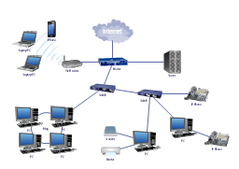

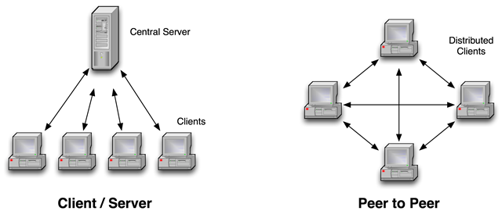
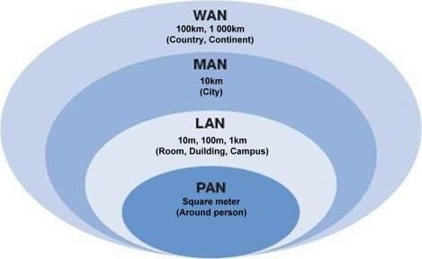
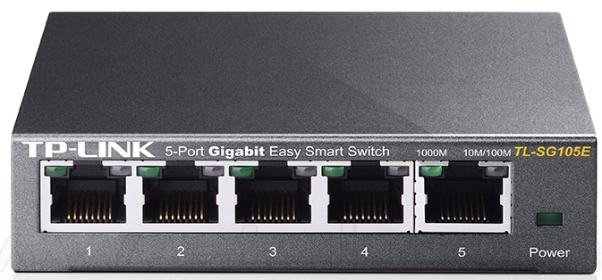
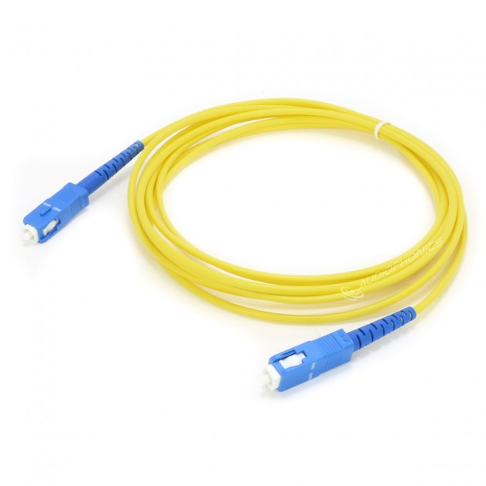
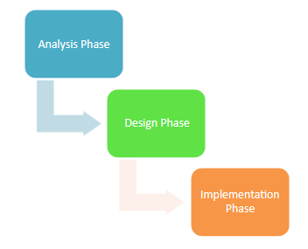
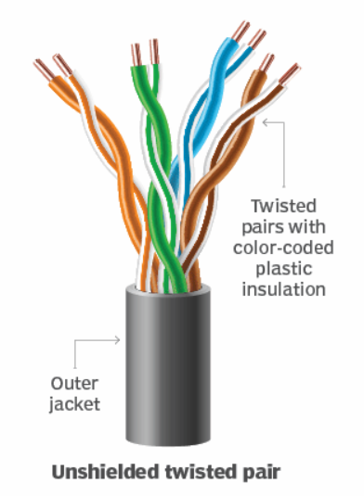
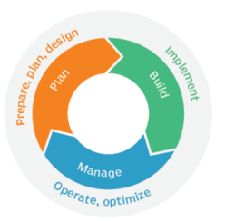
Flash Back
Computer Networks – Basic infrastructure of the current facilities which has uplifted the lifestyle of the mankind.
Five main components of a network communication
  Sender, Receiver, Data (Message), Medium, Protocols
Network Types
  PAN < LAN < WAN
Media
  Guided Media
    Coaxial, UTP, Fiber
  Unguided Media
    Wi-Fi, Mobile, Satellite, BT
Devices
  Device Orientation
  End Devices
    Devices which start and terminate the communication
  Intermediary Devices
    Active and Passive Devices
Designing a Network
  Requirements for a Network
  Outcomes
    Physical and Logical Design
  Network Development Models

Slide 3
Analyzing the requirements
Identify the business goals
  What the management needs to have?
Getting the Requirements
  User / Application / Device and Network
Analyze them and build priority Metrix
Collect background of existing networks ( traffic plots /graphs /logs and projections)
Analyze the technical options and set tradeoffs

Slide 4
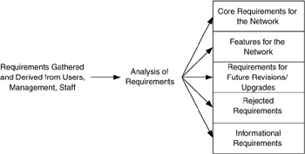
Requirements
Needs to Identify the requirements before Planning and designing
The process involve.
  Identify requirements
  Gather all requirements
  Classification and prioritized of requirements.
  Verify requirements and Priority
  Address them accordingly in the designing

Slide 5
Identification of Requirements
Requirements can come from many aspects of the network system
  Consider the Computer Network is like the Road Network
  User Requirements
  Application Requirements
  Device Requirements
  Network Requirements
  Other Requirements
  Technological Trends

Slide 6
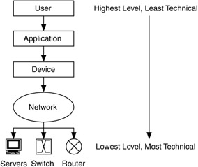
Requirements Analysis
How do we describe requirements for a network?
  Users are the main key .
  Difficult to provide all the requirements.
  Must address common ones first.
  Speed is a common topic but depend on multiple factors from user perception to hardware.

Slide 7
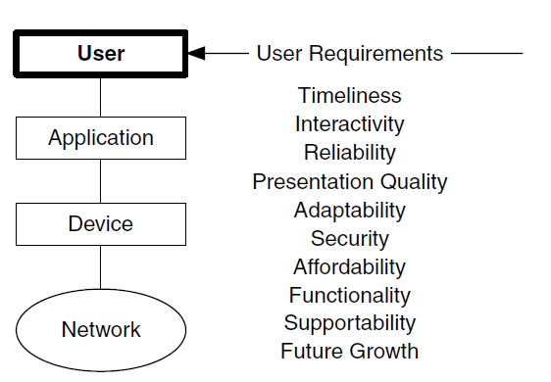

User Requirements
“What does it take to get the job done?”
The term user represents primarily the end users of the system
  It can be expanded to include everyone involved in the system, such as network and system administrators and management.
User requirements is the set of requirements gathered or derived from user input and is what is needed by users to successfully accomplish their tasks on the system.

Slide 8
User Requirements
Timeliness is a requirement that the user is able to access, transfer, or modify information within a tolerable time frame.
  E.g.: User may want to download a file and process and upload it within 10 minutes
Interactivity is similar to timeliness but focuses on a response time from the system
  User may need to do an online quiz within 10 minutes which needs answer selection, submission, loading new question etc.
Adaptability is the ability of the system to adapt to users' changing needs.
  Examples are in distance-independence and mobility.

Slide 9
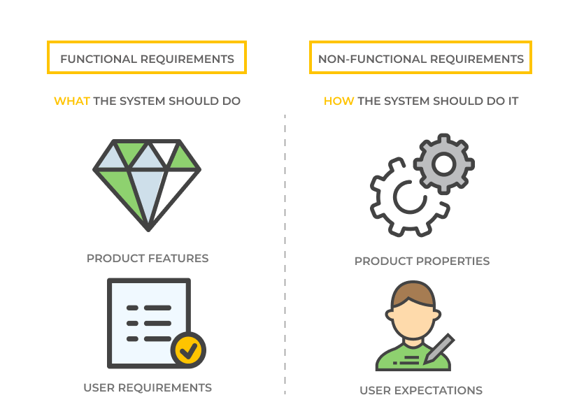
Application Requirements
What types of apps are we using?
  Mission-critical
  Rate-critical
  Real-time and/or interactive (Delay Sensitive)
How sensitive are apps to RMA (Reliability, Maintainability, Availability) of the network?
What capacity is needed?
What delay time is acceptable?
Application requirements are requirements
that are determined from application information, experience, or testing, and represent
what is needed by applications to successfully operate on the system.

Slide 10
Application Requirements
What groups of apps are being /will be used ?
  Web and related servicers
  Teleservice – VOIP, teleconference, telepresence, AOIP
  Operations, admin and maintenance of Network itself (DNS, SMTP, SNMP,NTP)
  Client-server base special/ business applications– ERP, SCM, CRM
  Visualization and simulation
  Command and control - remote devices (e.g. ATM)
  Distributed computing, Big data or grid applications.
  Bulk data transport – FTP

Slide 11
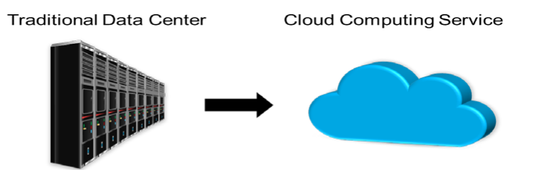
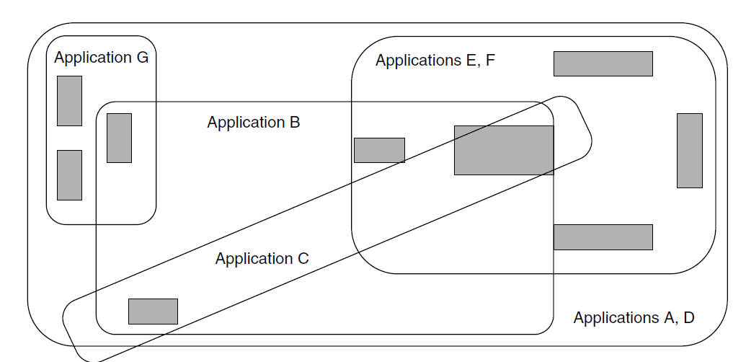
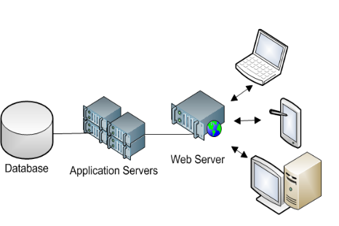
Application Requirements
Where are the apps hosted?- Cloud, Data center, Own server network
  user base/customer base
Where an application applies in your environment?
Time based behaver of apps.- off site backups , sync patterns, updates.
An Example Applications Map

Slide 12
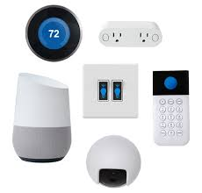
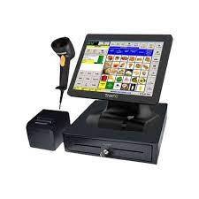
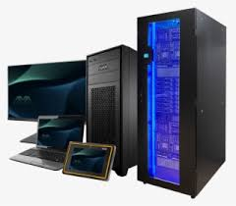
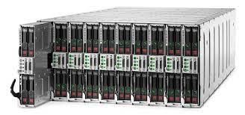
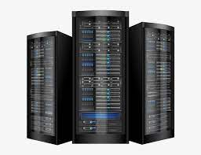
Device Requirements
What kinds of devices are on your network?
  Generic computing devices (PCs, Macs, laptops, handheld computers, workstations)
  Servers (all flavors of server – file, print, app, computation)
  Specialized devices (supercomputers, massively parallel servers), data collection systems (POS terminals), industry-specific devices, networked devices (cameras, tools, access control, medical equipment's ) VOIP ATMs, IOT, etc.

Slide 13
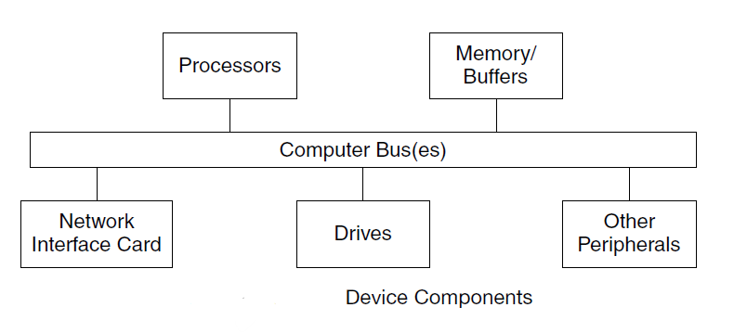
Device Requirements
We want an understanding of the device’s performance – its ability to process data from the network
  Device I/O rates, network dependency, interfacing technology and speeds
  Delay time for performing a given app function

Slide 14
Device Requirements
Performance results from many factors
  Storage performance, that is, flash, disk drive or tape performance
  Processor (CPU) performance
  Memory performance (access times)
  Bus performance (bus capacity, width and frequency)
  OS performance (effectiveness of the protocol stack and APIs)
  Device driver performance

Slide 15
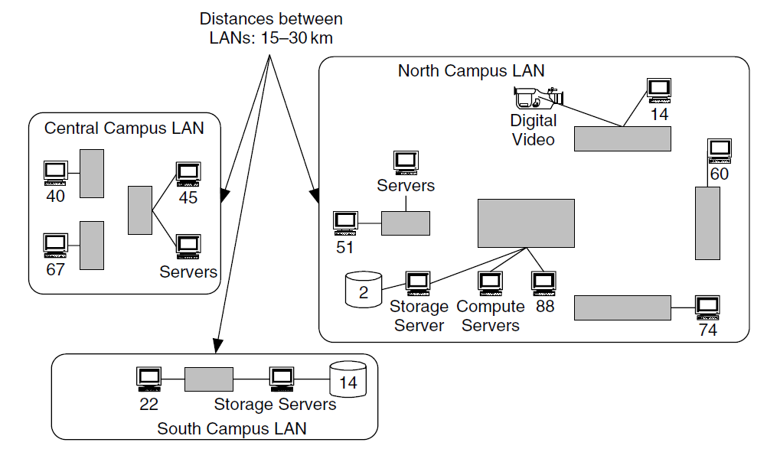
Device Requirements
Device Locations
  Knowing the locations of existing or expected generic computing devices, servers and specialized devices can be helpful in determining the relationships among users, applications, and networks, as well as the start toward determining traffic flow characteristics for the system.
  E.g.
    Distance between the LANs
    Distance between the devices and number of devices in a LAN

Slide 16
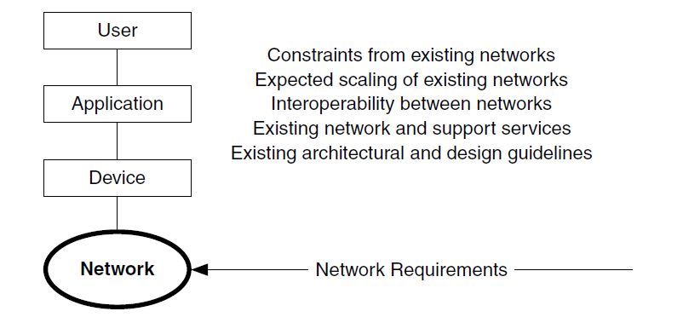

Network Requirements
Network requirements are the requirements for interacting with the existing /other network(s) and network management concerns
  Most networks may need to integrate with existing networks
  What is the plan for the future evolution of the network?
  What will happen to product specific protocols or technologies if the network become heterogeneous.

Slide 17
Network Requirements
Most network architectures/designs today need to incorporate existing networks.
  Few networks today are built entirely from scratch.
Issues with network integration include
  Scaling dependencies – how will the size of the existing network affect the new one?
    Will the existing network change structure, or just add on a new wing?
  Location dependencies – interaction between old and new networks could change the location of key components
  Performance constraints – existing network could limit performance of the new one

Slide 18
Network Requirements
    Network, system, and support service dependencies
      Addressing, security, routing protocols and network services
        DNS, DHCP
    Interoperability dependencies
      Changes in technology or media at the interfaces between networks need to be accounted ,Implementation of QoS.
    Network obsolescence/facing out of technologies and compatibility
      What will be the impact if a technology or protocall become obsolete during transition?

Slide 19
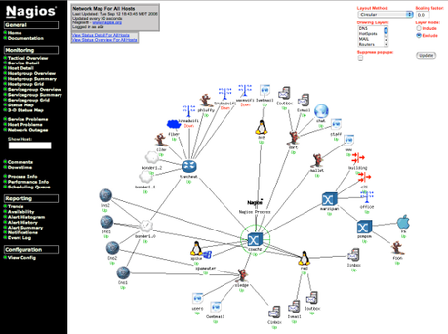
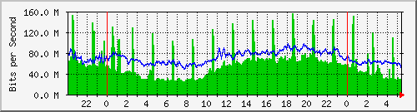
Network Requirements
Network Administration ,Management and security need to be addressed throughout development.
  How will the network be monitored for events?
    Thresholds and alerts.
  What factors to be monitored for network performance?
    What is the hierarchy for management data flow?
  Network configuration management
  Troubleshoot and Event management.

Slide 20
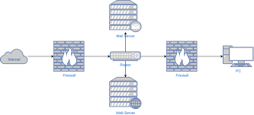
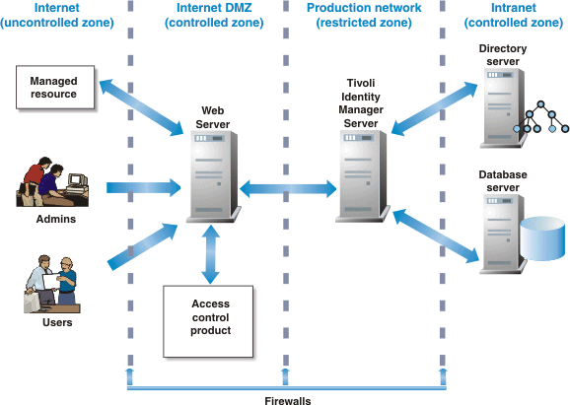
Network Requirements
Security of the network.
  What is the approach on security.
  How to secure end point.
Addressing the application level controls.
Zones with different security levels.
Bandwidth Vs filtering?

Slide 21
Other Requirements
Requirements can come from other outside sources –Customers, business partners, legal requirements, Organization (enterprise) requirements, etc.
Additional requirements can include
  Operational suitability – how well can the customer configure and monitor the system?
  Supportability – how well can the customer maintain the system?
  Conformity to standards and security

Slide 22
How to prioritized the requirements
What factors to be considered
The requirement VS cost to address.
Business priority.
Can the requirement to be address in future with minimum impact.

Slide 23
Operational Requirements

Slide 24
Service Metrics
Service metrics for delay include:
  End-to-end or round-trip delay
  Latency
  Delay variation
SNMP or CMIP (Common Management Information Protocol) can be used to configure these metrics, which are kept in the Management Information Base (MIB)

Slide 25
Service Metrics
Variables often used as service metrics:
  Bytes in/out (per interface)
  IP packets in/out (per interface)
  Dropped Messages per time per interface
  Service-level agreement (SLA) metrics (per user)
  Capacity limit
  Burst tolerance
  Delay
  Downtime

Slide 26
Operational Requirements (RMA)
Reliability is a common measurement
  Mean time between mission critical failure (MTBCF) focuses on failures during certain time periods, excluding planned down times
  Mean time between failure (MTBF) includes failure at any time.
Maintainability is typically captured with mean time to repair (MTTR)
  Time to rectify an issue is critical since service will be back to normal only after the rectification.

Slide 27
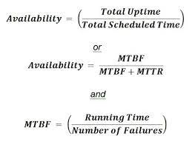
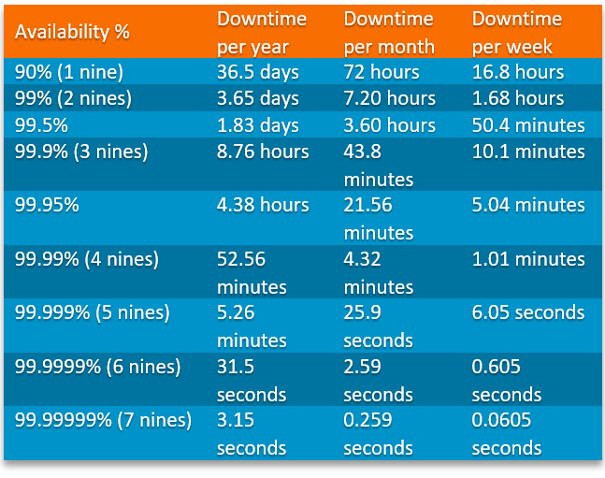
RMA Requirements
Availability relates failures to repair time
  Availability, in terms of MTBF, MTBCF, MTTR
  Scheduled maintenance time doesn’t count against availability
Uptime and downtime measure those percentages when the system is up or down
  The upper practical limit is 99.999% uptime, which is 5.3 minutes of downtime per year
  Uptime of 99.99% is common
  How many events occur is also important

Slide 28
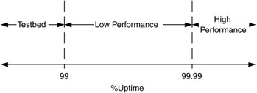
RMA Requirements
Thresholds and limits can be defined for RMA measures
  MTBF is typically a couple thousand hours
  MTTR may be a few hours
Different parts of the system may have different requirements on uptime ,latency, capacity, throughput etc

Slide 29
Delay Requirements
Various delays can have a strong impact on network requirements
  Interaction delay (INTD) is how long a user will wait for a response from the system
  Human response time (HRT) is estimate of the time threshold at which users begin to perceive delay in the system.
    Thus, when the system response time is less than HRT, users generally do not perceive any delay in the system.
    For delays greater than HRT, users generally do notice the system delay.
  Network propagation delay is an estimate of how long it takes for a signal to cross a physical medium or link

Slide 30
Delay Requirements
End-to-end and round-trip delays can be network requirements
  We can used ping to get RTT (round trip time)
Delay variation can be defined for multimedia apps – typically is 1-2% of end-to-end delay.
  The propagation delay is always exsist but is this delay is constant or is vary with time or any other factor.
  Can it be fixed than been a variable factor?
  Smoke ping is an application to display it graphically.

Slide 31
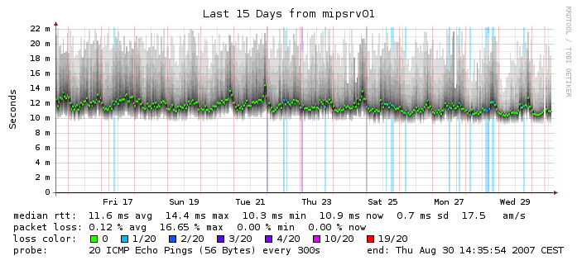
Smokeping Application
SmokePing is a deluxe latency measurement tool, a free, open-source project.
It can measure, store and display latency, latency distribution and packet loss.

Slide 32
Capacity Requirements
What is the capacity requirements
  Peak data rate
  Minimum acceptable data rate
  Sustained (long term) data rate
This to be identified from applications and their requirements from various physical areas.

Slide 33
Data Rates
Data rate is one important parameter related to performance .
Data rates for an app can be measured at many levels of the protocols
  App, network, etc.
  Most TCP apps will take what’s available, but back off when the network gets crowded (why?)
    Congestion control in TCP
Often we may need to identify where the performance bottleneck is located and why?

Slide 34
Typical Application Capacity Requirement
Application | Average Completion Time (Seconds) | Average Data Size (Bytes)
Distributed Computing (Batch Mode) | 10³ | 10⁷ =10MB
Web Transactions | 10 | 10⁴ = 10KB
Database Entries/Queries | 2–5 | 10³ = 1 KB
Payroll Entries | 10 | 10² = 100B
Teleconference | 10³ | 10⁵ = 100KB

Slide 35
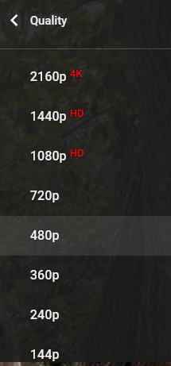
Data Rates
Sometimes a range of values is more helpful
  Processing credit card info might take 5-10 seconds, and require 100-1000 bytes of data
Multimedia rates are well known, and depend on the protocol and level of compression and quality desired by users( Eg HD,4K)

Slide 36
Operational Suitability
Operational Suitability is making sure your customer can operate/manage the network once it’s running
  How often are manual network adjustments needed?
  How often does network configuration change?
  How much monitoring is automated

Slide 37
Operational Suitability
How many shifts of operators will there be?
How well trained are the network operators?
How often will hardware changes be needed?
  What hardware can the operators change?
  What level of component is an operator can change? Chip, board, rack unit, entire rack? (Line-Replaceable Unit, LRU)

Slide 38
Supportability
Can the network’s level of performance be sustained over time?
This is affected by
  RMA of the architecture and design
  Workforce, including training and staffing levels
  System procedures and technical documentation
  Tools, both ordinary and special
  Spare and repair parts

Slide 39
Supportability
Maintenance of a system expects
  Components are located where they can be maintained without affecting the rest of the system much
  Spare parts are supplied to allow replacement of failed and soon-failed components
Reliability can be formally modeled with reliability block diagrams (RBDs) or failure mode and effect analysis (FMECA)

Slide 40
Supportability
Workforce should be equivalent to the ones being replaced; or at least as cheap overall
Documentation typically includes
  Technical documentation of the system configuration, design, parts, etc.
  Maintenance procedures describe routine actions
  Casualty or corrective procedures describe how
  to troubleshoot, debug, or otherwise fix basic problems

Slide 41
Supportability
Tools and test equipment describe what tools are needed to maintain the system
  How are faults detected?
  How is performance being monitored?
  What capabilities will be available to remotely diagnose, reconfigure, or reset components?
Stuff breaks and wears out, so spare parts are needed to improve availability
  How much are you will to invest in parts?
  What WH component to be on site , off site, with SLA…?

Slide 42
Supportability
What type of supportability ,who will be provided?
Difference tiers of support ( often refer as Level)
  Onsite
  Central maintenance/Help desk
  Service provider/supplyer.
  Manufacturer

Slide 43
Supportability
Level | Tools and Test Equipment | Corrective Maintenance | Preventive Maintenance
Organizational | Common tools Operator consoles and controls Inexpensive special tools | Day-to-day monitoring Troubleshooting Fault isolation Reconfiguring system | Monitoring performance Minor on-site cleaning and adjustments
Intermediate | Special or expensive portable tools with limited use | On-site repair of offline equipment | Major on-site upgrades Supplement operators
Depot | Equipment to refurbish components | Overhaul and refurbishment | Scheduled overhaul or disassembly of LRUs

Slide 44
References
Network Analysis, Architecture and Design, Second Edition (The Morgan Kaufmann Series in Networking)
https://flylib.com/books/en/2.809.1.25/1/

Slide 45
QR

